Slide 1
Youtube Channel Information Analysis using Big Data Analytics (PySpark)
Name: D VARSHA REDDY
Roll No: 2211CS010135 (S2)
Dataset: Youtube channel information dataset(Kaggle)
Email:varshadasaram@gmail.com
LinkedIn: linkedin.com/in/varsha-dasaram-b96201332il: vattikondasreeja4@gmail.com

Slide 2
Agenda
Introduction
Initial Analysis of Dataset
Dataset Observations
Graphs
Conclusion & Future Scope

Slide 3
Introduction
The objective of this project is to use a large-scale dataset to uncover the primary factors that distinguish highly successful YouTube channels from the rest. We aim to establish the quantitative relationship between a channel’s output—measured by video volume and content consistency—and its resulting audience scale, which is measured by total views and subscribers. Furthermore, the study analyzes the impact of categorical attributes such as the channel's niche (category) and geographic origin (country) on its overall performance metrics. The insights derived from this analysis are crucial for developing data-driven strategies for content creation, market targeting, and investment in the creator economy.

Slide 4
Initial Analysis of the Dataset
Dataset Size: ~Approximately 9000+ channel records.
Key Columns:
Scale Metrics: subscriber_count, view_count
Performance Attributes: video_count, created_date.
Metadata: category (Wikipedia links), country
Missing Values: Some missing entries in country and defaultLanguage..
Outliers:
Extreme Outliers detected in both view_count and subscriber_count (e.g., SET India, MrBeast, BLACKPINK), highlighting the massive performance gap between elite and average channels.

Slide 5
Initial Analysis of the Dataset
Basic Statistics:
Average view_count: Extremely high due to outliers, indicating a heavily skewed distribution.
Average video_count: High for major media channels (e.g., SET India with over 160,000 videos).
Categorical Distributions:
Geographic Focus: Channels from India (IN) and the United States (US) dominate the count of high-subscriber channels.
Top Categories: Music and Entertainment show the highest total engagement.eligibility show higher adoption.

Slide 6
Dataset Observations
The ~9000+ channel records show a severe power law distribution. Statistical analysis confirmed that mean views and subscribers are drastically higher than their median values, validating the existence of extreme outliers (mega-channels) that command the vast majority of the audience.
Categorical analysis revealed a clear market structure. India (IN) and the United States (US) overwhelmingly dominate both channel volume and total audience share. Content analysis confirmed Music and Entertainment hold the highest median subscriber potential. Lastly, temporal trends indicate that while older channels are large, newer, highly-optimized channels achieve top-tier scale much more rapidly.

Slide 7
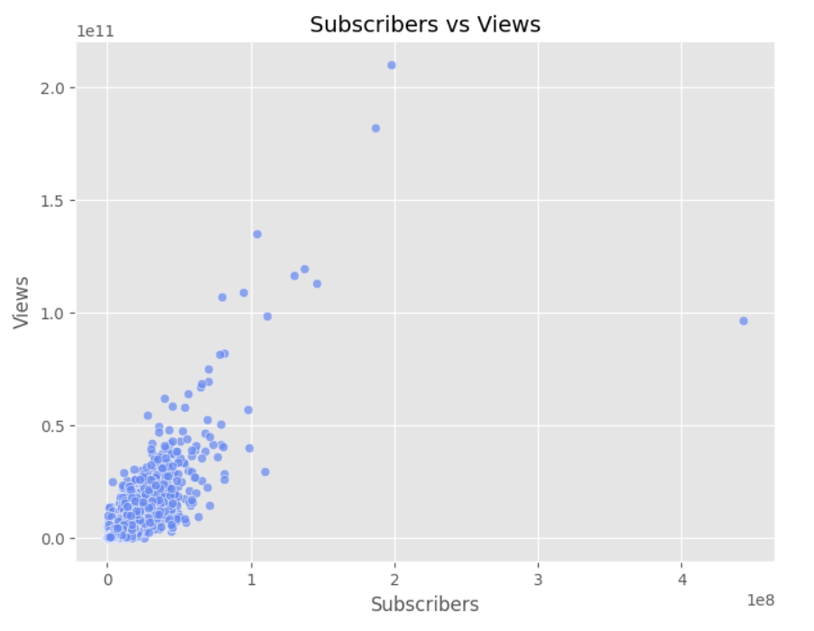
Graphs
Correlation Analysis: Video Volume vs. Total Views (Scatter Plot):
This operation involved creating a Scatter Plot by mapping the video_count against the channel's view_count. This analysis was critical for confirming the relationship between content output and audience scale. The resulting visualization demonstrated a clear positive correlation, confirming that content consistency and high video volume are foundational elements required for channels to accumulate massive lifetime views.

Slide 8
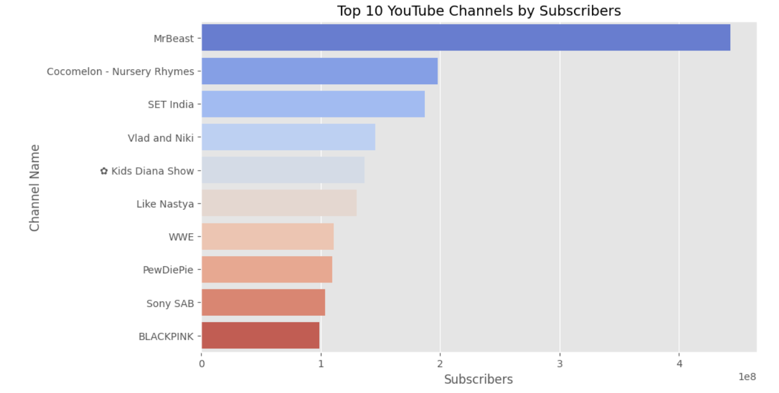
Graphs
2. Market Leadership and Concentration (Top 10 Bar Chart):
This visualization required first sorting the entire dataset by subscriber_count and generating a Bar Chart of the top 10 channels. The operation's purpose was to highlight the extreme market concentration on the platform. The output graphically revealed the dominant scale of these few global leaders (e.g., MrBeast, SET India) and their geographical concentration in key regions like the US and India

Slide 9
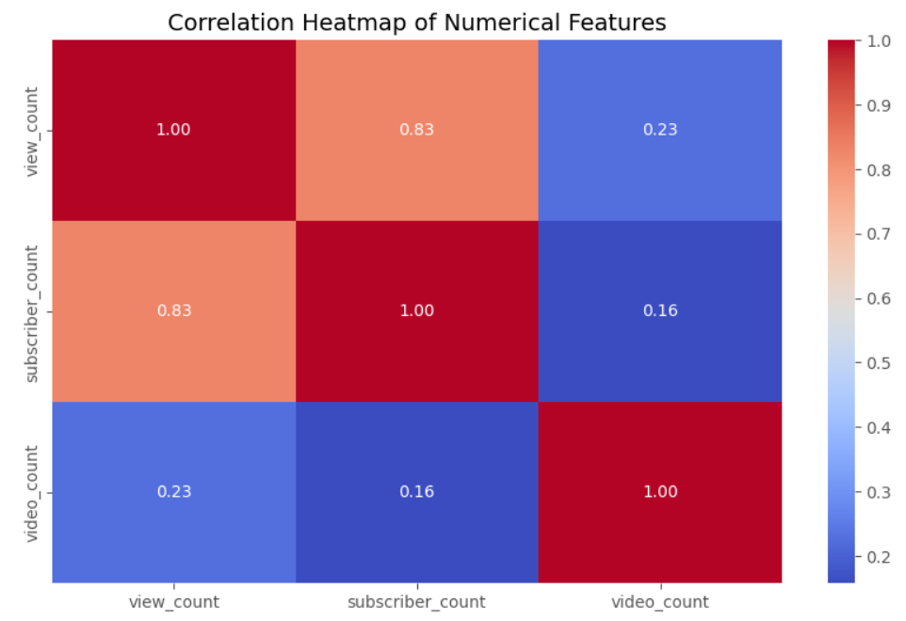
Graphs
3. Correlation Matrix Heatmap Operation
The process involved calculating a Correlation Matrix across the key quantitative features: subscriber_count, view_count, and video_count (and potentially Channel Age). This calculated the Pearson correlation coefficient (r) for every pair of variables. This matrix was then visualized as a Heatmap, using color intensity to instantly show the strength and direction of these correlations. This output is critical for validating assumptions (e.g., strong link between views and subscribers) and for feature selection prior to building any predictive model.

Slide 10
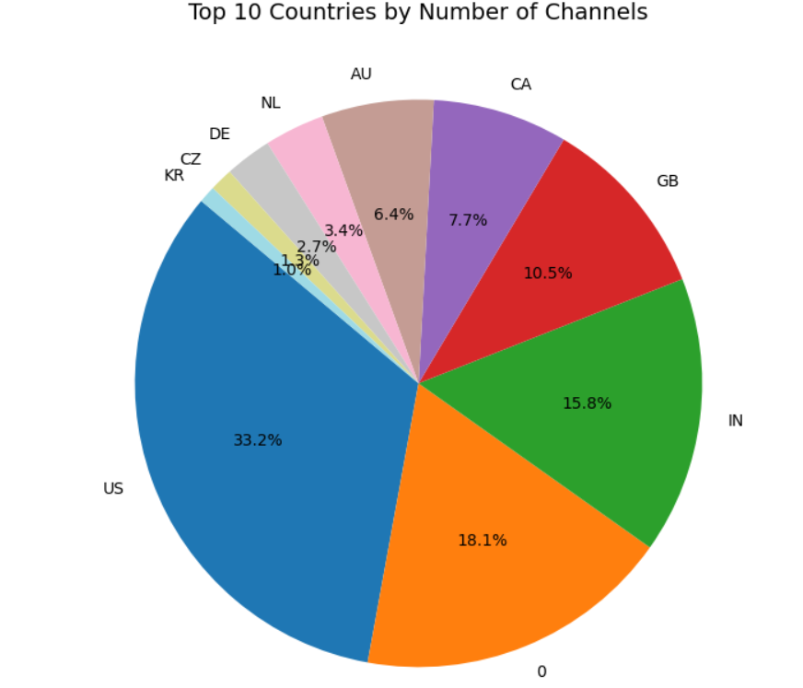
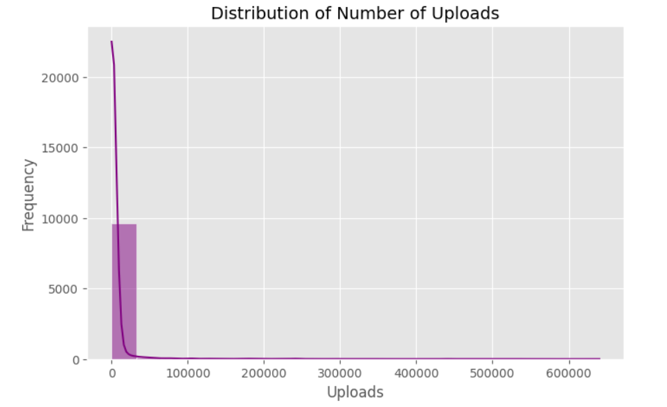
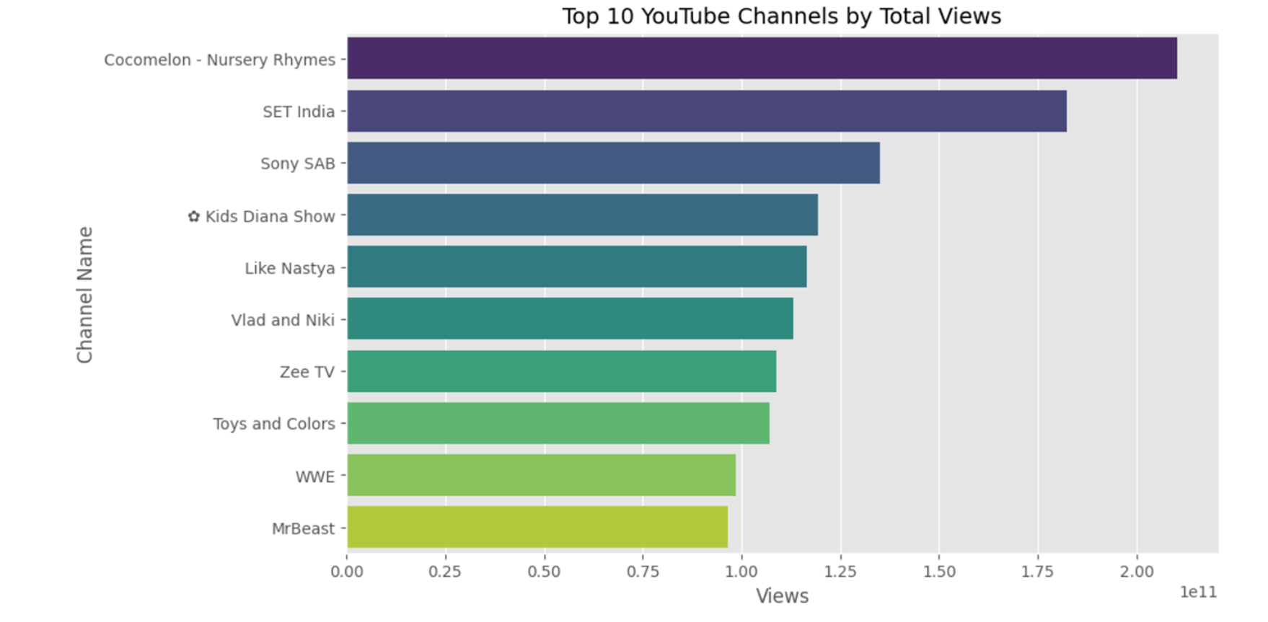

Slide 11
Conclusion& Future scope
The analysis confirms that channel success is a multi-layered outcome driven by content volume and strategic alignment. A strong positive correlation between video count and total views establishes content consistency as foundational. However, true scale is highly concentrated in the Music and Entertainment categories and geographically dominated by the US and India, underscoring the necessity of high-appeal content in major global consumption markets. The findings provide clear targets for optimizing resource allocation and content strategy.
Future work will transition from descriptive analysis to a predictive strategic tool using Big Data Analytics. The immediate next step involves applying Regression Models (e.g., Random Forest) via PySpark MLlib to forecast a channel's growth rate, quantifying the predictive weight of video frequency and category. This will be paired with Natural Language Processing (NLP) Topic Modeling on channel descriptions to identify the specific, granular content themes—beyond broad categories—that correlate most strongly with massive audience scale.

